Slide 1
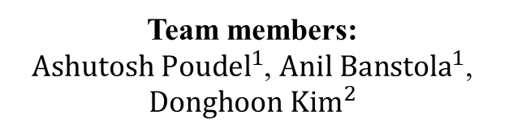
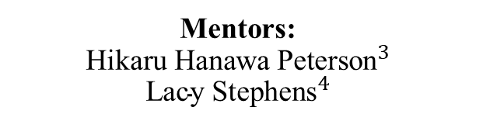
HEALTH AND ENVIRONMENT FROM ACCESSIBLE AND AFFORDABLE LOCAL FOOD (HEAL INDEX)
Team members:
${Ashutosh Poudel}^{1}$, ${Anil Banstola}^{1}$, ${Donghoon Kim}^{2}$
Mentors:
$${\text{Hikaru} \text{Hanawa} \text{Peterson}}^{3}$$
$${\text{Lacy} \text{Stephens}}^{4}$$
¹ Department of Agricultural & Applied Economics, University of Georgia, M.S. student
² Department of Agricultural and Resource Economics, University of Connecticut, Ph.D. Candidate
³ Department of Applied Economics, University of Minnesota Twin Cities, Professor
⁴ Marketing and Regulatory Programs (MRP) Agricultural Marketing Service, Agricultural Marketing Specialist (AMS)

Slide 2
What makes a strong food system?
Affordability:
Provide enough, fresh, and nutritious food to diverse population.
Accessibility:
Be accessible for local consumers irrespective of location.
Environment:
Assess the system's environmental sustainability and impact on ecosystems.
Health:
Promote better nutrition to foster a more equitable food system, better nutrition, and overall community health.

Slide 3
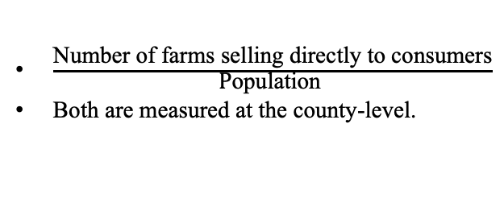
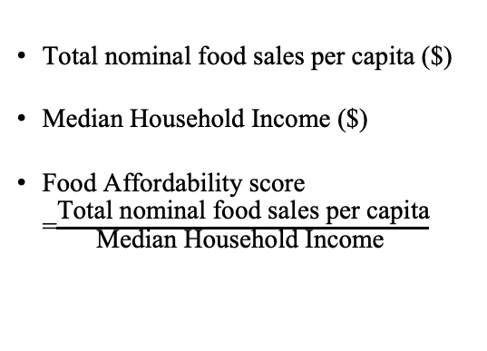
Exploring the Variables
Local Food Accessibility
Food Affordability
$\frac{\text{Number} \text{of} \text{farms} \text{selling} \text{directly} \text{to} \text{consumers}}{\text{P}\text{opulation} }$
Both are measured at the county-level.
Total nominal food sales per capita ($)
Median Household Income ($)
Food Affordability score =$\frac{\text{Total} \text{nominal} \text{food} \text{sales} \text{per} \text{capita}}{\text{Median} \text{Household} \text{Income} }$

Slide 4
Exploring the Variables
Environment
Health
Adult obesity rate
Diagnosed adult diabetes rate
Food insecurity rate
Fast-food restaurants/1000 capita
% harvested acres treated with chemical fertilizer
% harvested acres treated with chemical pesticides, insecticides and herbicides
% farm acres under conservation easement
% farm acres under no till
% farm acres planted to cover crops
% number of farms (organic, exempt, or transitioning)
% number of farms (rotational or management intensive grazing)
% number of farms (practicing alley cropping and Silva pasture)

Slide 5
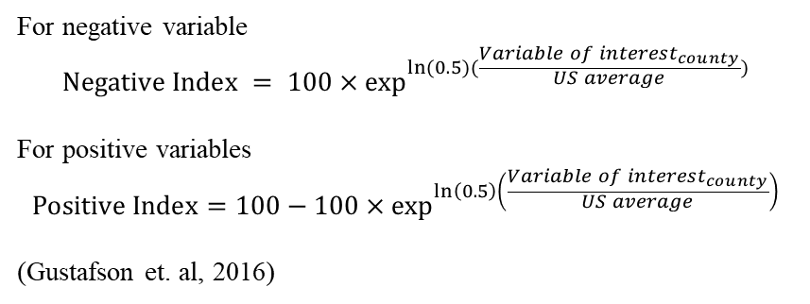
Methodology for HEAL Index
Standardizing all variables
Standardizing formula
All variables used for each dimension are standardized on a scale of 0 to 100 divided by the US mean value.
For negative variable
$$Negative Index = 100×\exp^{ln(0.5)(\frac{{Variable of interest}_{county}}{US average})}$$
For positive variables
$$Positive Index=100−100×\exp^{\ln\left(0.5\right)\left(\frac{{Variable of interest}_{county}}{US average}\right)}$$
(Gustafson et. al, 2016)

Slide 6



HEAL Index
Our final HEAL Index is the unweighted average of the standardized aggregation of each dimension.
Value ranges from 0 to 100
Food Affordability
Local Food Accessibility
Strong & equitable local food system
Environment
Health

Slide 7
So, what does HEAL Index mean?
It measures the strength of local food system based on local food accessibility, food affordability, dietary health of people and the environmental impact from food providing activities.
The Index value closer to 100 means stronger food system and closer to 0 means weak food system (US average: 50).
The index captures the interconnection between food production to consumption that are associated with health conditions and the sustainability of local environment.

Slide 8
Visualizing the Index
Main
Heatmaps: spatial variation at the county level across states.
Supporting Charts
Spider chart: Variation in the strength of each dimension at the state level.
Density plot: Distribution of each dimension across two states at the county level.

Slide 9
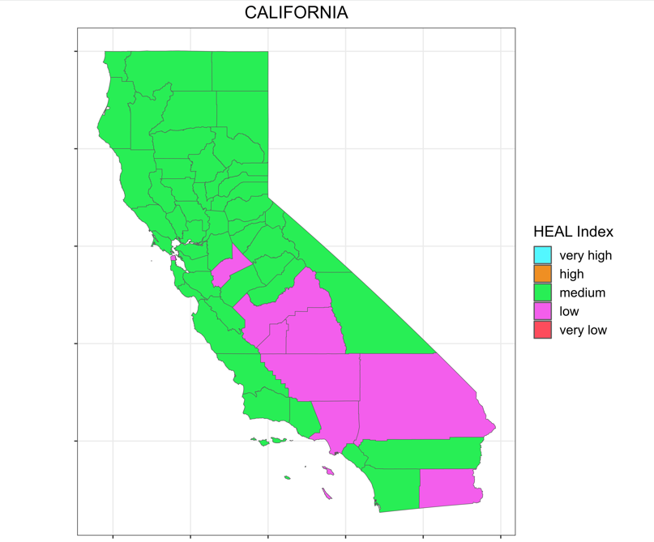
Heatmap of California
15% counties in California have low HEAL index value while the remaining 85% are ranked medium.

Slide 10
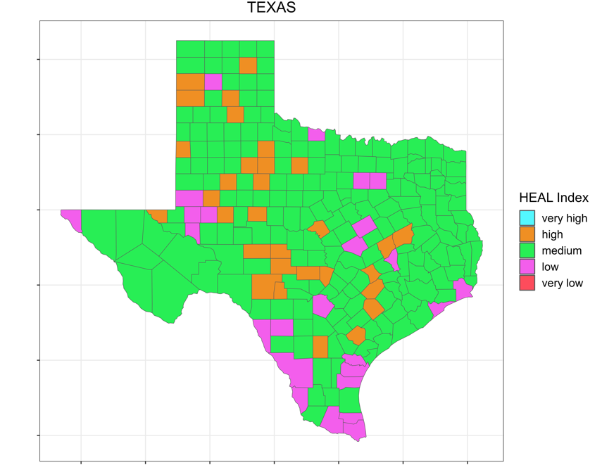
Heatmap of Texas
In Texas, 10% of counties have low HEAL score, followed by 12% ranked high and rest 78% ranked medium.
This implies that the local food system across Texas counties is slightly stronger than the counties in California.

Slide 11
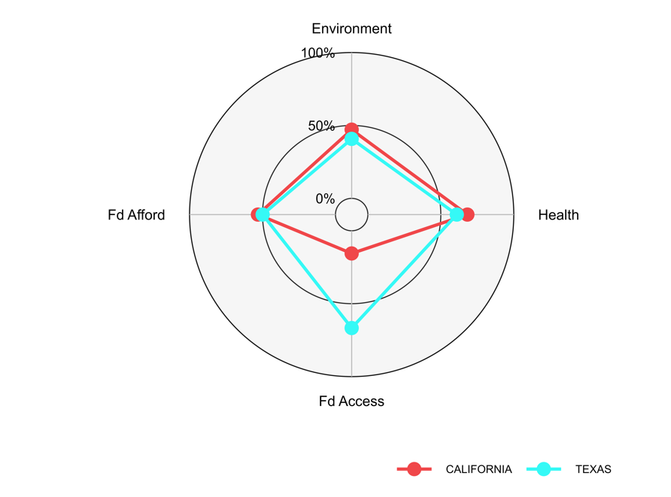
Spider-Chart (Radar Chart)
Spider-Chart
The Spider-Chart visualizes the variation in the strength of four dimensions at the state level.
Here, Texas has better local food accessibility than that of California while all other dimensions are comparable.
Figure: Spider-Chart of HEAL Dimensions for California and Texas

Slide 12
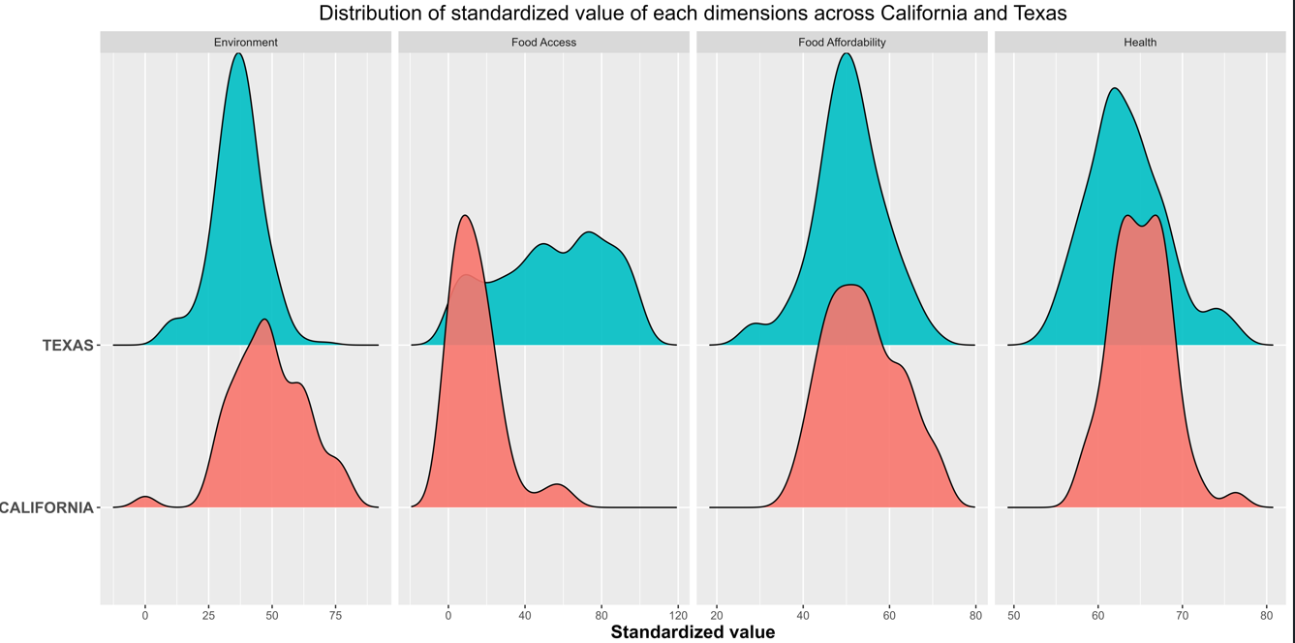
Ridge Map
Figure: Ridge Map of HEAL Dimensions’ distribution among counties in California and Texas

Slide 13
Data Sources
Dimensions | Variables | Sources
Food Accessibility | The number of farms (DTC) | FAME/Census of Agriculture
 | Population (county) | American Community Survey
Food Affordability | State food sales per capita | Food Expenditure Series, USDA, ERS
 | Household median income (county) | American Community Survey
Environment | GHG emission, chemical pollution and soil health, carbon footprint (kg co2eq/kg produce), and chemical pollution and soil health. | United States Department of Agriculture National Agricultural Statistics Service (NASS), Census of Agriculture
Health | Diagnosed diabetes in adults | US Diabetes Surveillance System
 | Obesity among diabetic adults | US Diabetes Surveillance System
 | Food insecurity rate | Data warehouse
 | Fast-food restaurants per 1000 people | FAME/Census of Agriculture

Slide 14
References
Chaudhary, A., Gustafson, D., & Mathys, A. (2018). Multi-indicator sustainability assessment of global food systems. Nature Communications, 9(1), 848.
Gustafson, D., Gutman, A., Leet, W., Drewnowski, A., Fanzo, J., & Ingram, J. (2016). Seven food system metrics of sustainable nutrition security. Sustainability, 8(3), 196.
Remans, R., Wood, S. A., Saha, N., Anderman, T. L. & DeFries, R. S. Measuring nutritional diversity of national food supplies. Glob. Food Sec. 3, 174–182 (2014).
Carson, J., & Boege, S. (2020). The Intersection of Food Availability, Access, & Affordability with Food Security and Health. Working paper. University of New Hampshire.

Slide 15
Thank You!!

